Slide 1

Fall2019
IS590 PR Final Project
Analysis data sets, Test scientific hypotheses
Name: Chang Li, Yunlu Pan

Slide 2
Data sets
World Happiness Reports (Year 2015, Year 2016, Year 2017)
From Kaggle https://www.kaggle.com/unsdsn/world-happiness
Includes 160+ countries happiness score and rank
Also has six factors GDP per Capita, Family, Life Expectancy, Freedom, Generosity, Trust Government Corruption
National Footprint Accounts 2018 – The Ecological Footprint of 196 Countries
From Kaggle https://www.kaggle.com/footprintnetwork/national-footprint-accounts-2018
87021 rows and 15 columns
Shows Ecological Footprint of Consumption for 196 countries from data years 1961 to 2014

Slide 3
Data sets
World Economic and Financial Surveys – World Economic Outlook Database – WEODataCPI
World Economic and Financial Surveys – World Economic Outlook Database – WEODataGDP
From the organization of International Monetary Fund https://www.imf.org/external/pubs/ft/weo/2019/02/weodata/index.aspx
Contains selected macroeconomic data series from the statistical appendix of the World Economic Outlook report, which presents the IMF staff's analysis and projections of economic developments at the global level, in major country groups and in many individual countries.

Slide 4
Hypotheses
Countries which have higher GDP and CPI are happier
Countries which have bigger ecological footprints are happier
The people who live in happier countries are healthier

Slide 5

Functions

Slide 6
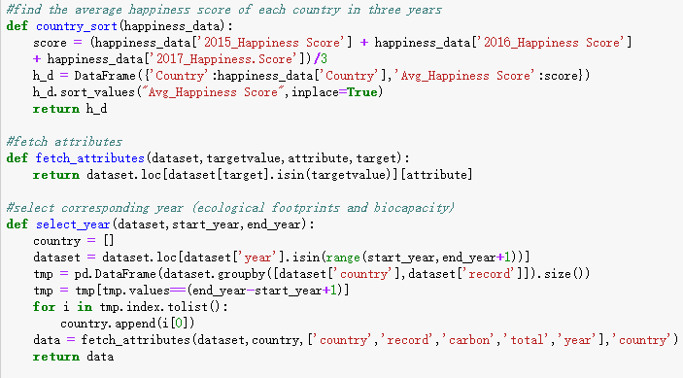

Functions

Slide 7
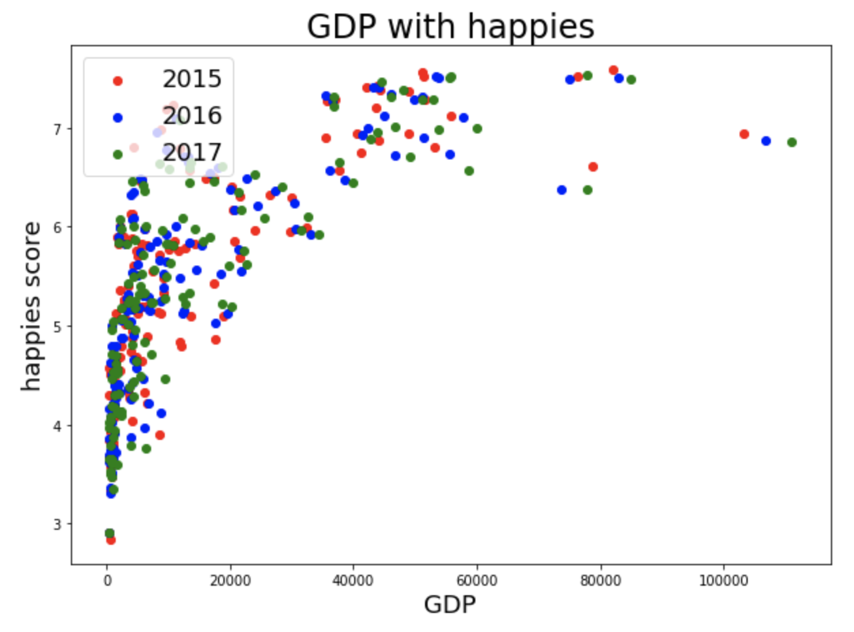
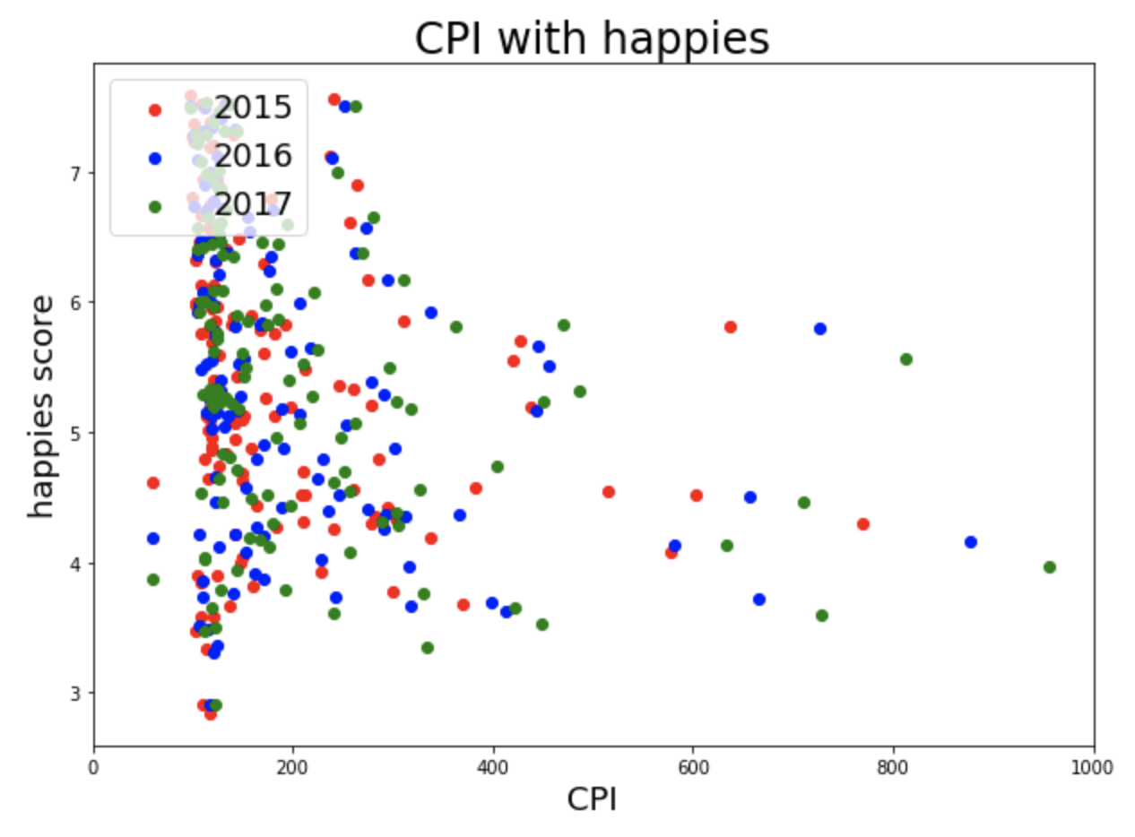
Results -Countries which have higher GDP and CPI are happier

Slide 8
Conclusion
Original Hypothesis: Countries which have higher GDP and CPI are happier
From analysis result: Countries which have higher GDP are happier, but CPI has not obvious relationship with happies.

Slide 9
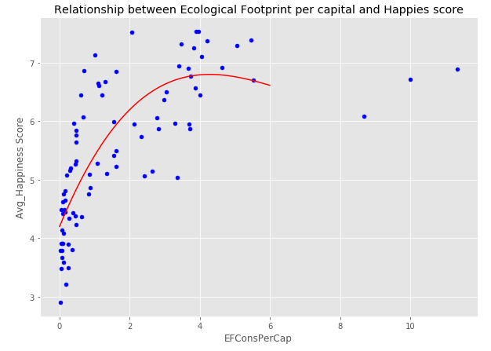
Results -Countries which have bigger ecological footprints are happier

Slide 10

Model & Conclusion
With the increase in carbon emissions per capita, countries will gain higher happiness scores. However, after they reach the maximum score, more carbon emission will cause a decrease in the happiness score.

Slide 11
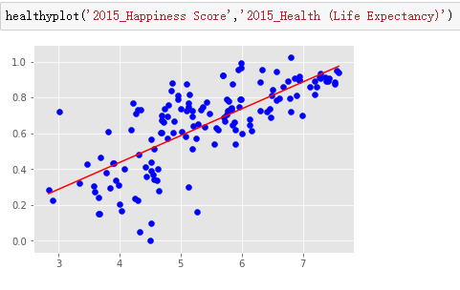
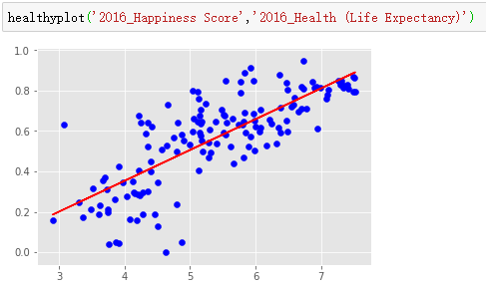
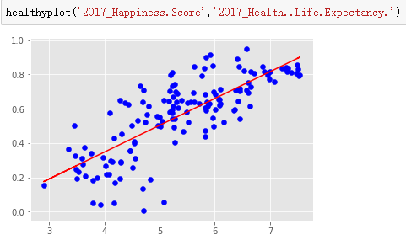
Results -The people who in happier countries are healthier

Slide 12

Model & Conclusion
After analyzing the countries from 2015 to 2017, we conclude that countries which are happier have longer life expectancy. People in happier countries are healthier.

Slide 13
Q&A

Slide 14
Thank you

